Slide 1
Carbon Pricing in Electricity Markets: Overview, Policy Design and Recent State Actions
Karen Palmer Resources for the Future
Energy Policy Roundtable in the PJM Footprint #16 Webinar April 28, 2020
With input from Dallas Burtraw, Kathryne Cleary, Dan Shawhan and Paul Picciano

Slide 2
Drivers for carbon pricing
Emissions reductions
Essential for addressing climate change
Encourages fuel switching to lower carbon fuels
Potentially encourages a reduction in energy demand, depending on use of proceeds
Economic efficiency
Electricity generation produces carbon dioxide which contributes to climate change.
Pricing carbon will internalize the social cost of emissions
Carbon pricing is the lowest cost option for reducing emissions by a fixed amount.
Promotes innovation and investments to achieve a reliable and affordable resource mix in the long run
Control technologies for CO₂ are evasive & difficult to implement in the power sector
A carbon price increases the value of low-carbon resources
Magnitude of the carbon price matters
2

Slide 3
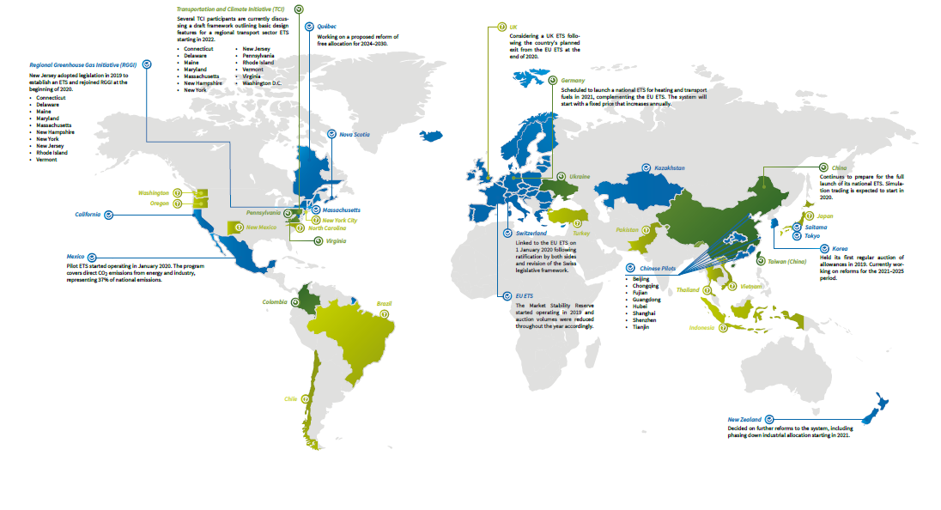
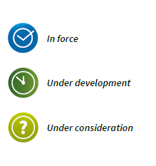
Existing Carbon Prices
Source ICAP Emissions Trading Worldwide Status Report 2020

Slide 4
Existing Programs and Prices
*Based on the 3% discount rate scenarios

Slide 5
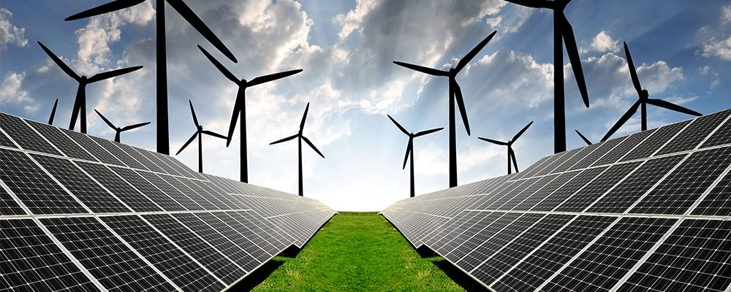
Policy Interactions Matter
Electricity policies: RPS, EERS, Clean Energy Standards, etc.
Economic theory paints overlapping policies as departure from efficiency
Yet companion policies are a fundamental feature of climate strategies globally
Interactions depend on form of carbon policy: direct price versus cap and trade
In the US, most states pursuing carbon policy have adopted cap and trade
Notes:
When you think of climate policies in the US (federal, state or local level?), what comes to mind?
Companion policies are any policies affecting carbon emissions beyond carbon pricing. Include regulatory standards and technology-specific subsidies
-renewable portfolio standards, subsidies for renewables and nuclear, energy efficiency, vehicle GHG standards (CAFE)
-companion policies can be sub-jurisdictional measures too, like a state RPS or even an additional carbon price in a state
-other environmental policies can also affect carbon emissions. For example, policies under the Clean Air Act like permitting for power plants aimed at reducing local air pollution

Slide 6
Dilemma: Additionality under an Emissions Cap
Cap and trade: Emissions reductions from companion policies lead to the waterbed effect
An emissions cap is an emissions floor, leading to 100% leakage of individual efforts (at least in the short term)
Prices fall, and emissions go up somewhere else!
Carbon Pricing in Electricity Markets: Overview, Policy Design and Recent State Actions

Slide 7
Supply Schedules in N. American Carbon Trading Programs
(in effect in 2021)
Intended Cap
Price Ceiling
Intended Cap
P_{max}
Western
Climate Initiative
RGGI
Cost Containment Reserve
Emissions Containment Price Point
Cost Containment Price Tiers
Price Floor
Price Floor
P_{min}
0
0
tons
Quantities with Prices
Lower allowance demand reduces both prices and emissions.

Slide 8
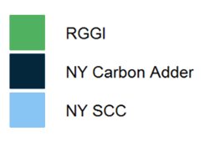
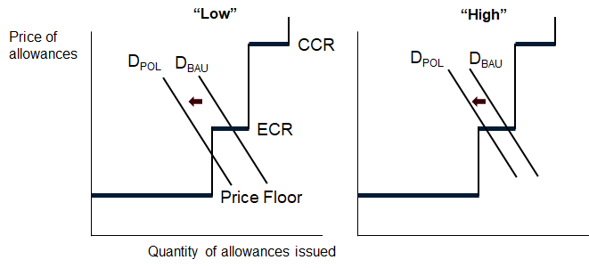
Effects of NYISO Carbon Pricing Proposal on RGGI Allowance Prices and Emissions
BAU and Policy in 2025 (2013$ / ton)
Low Renewable Cost
High Renewable Cost
Low Renewable Cost
High Renewable Cost
The BAU RGGI Price is on ECR Step in both cases. Under “Low” costs, it falls below the step under the Policy, with the entire ECR quantity withheld from the market. Under “High” costs, the price remains on the step.

Slide 9
Leakage to Unpriced Regions
Leakage refers to the change in emissions outside the jurisdiction.
The higher the carbon price, the greater the potential problem
Price leakage also may occur, where the electricity price in a neighboring jurisdiction goes up via the wholesale market

Slide 10
Program Design can Reduce Leakage
Investment in energy efficiency (RGGI) or other technologies reduces leakage
Output based allocation (free allowances) to generators provides a production incentive that mitigates leakage
Border adjustments are also possible

Slide 11
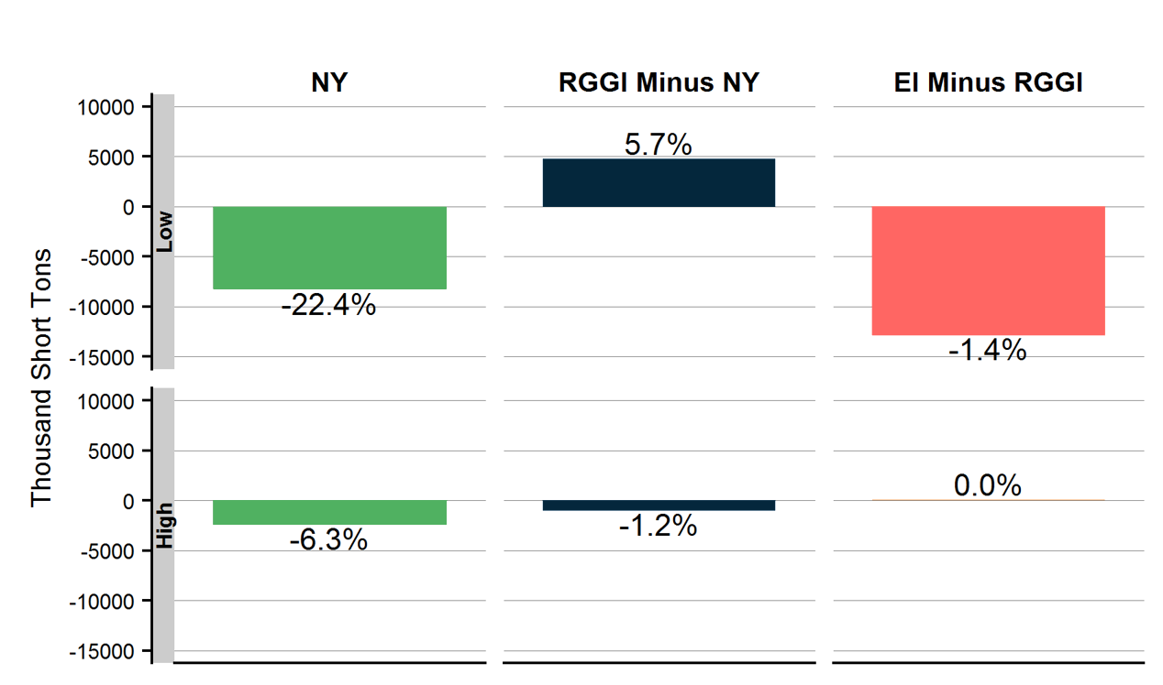
Effects of NYISO Carbon Pricing Proposal on CO₂ Emissions
Change from BAU in 2025 (Thousand Short Tons)
The New York Carbon Pricing Proposal reduces CO₂ emissions in New York and reduces them even more in the Eastern Interconnection (EI) as a whole (negative leakage).

Slide 12
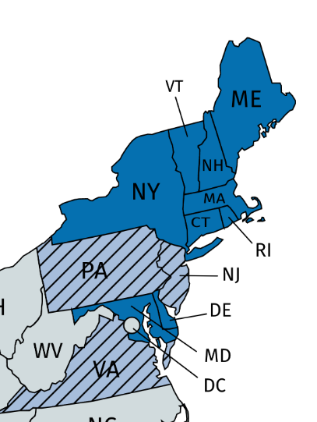
RGGI: 9 becomes 10 becomes 11 (12?)
New Jersey rejoined RGGI in 2020
Using much of allowance revenue to promote vehicle electrification
Virginia will join in 2021
Will substantially increase the size of RGGI cap
28 % increase in unadjusted cap / 38% increase in adjusted cap in 2020
Recently switched to revenue raising auction from free allocation
Lots of companion policies to promote renewables and EE and shut down coal (Virginia Clean Economy Act)
Data Center related load growth could be a factor
Pennsylvania is crafting its CO₂ cap and trade policy now
Emissions caps still TBD; considering automatic bank adjustment
RFF modeling suggests if state adopts RGGI-like trajectory for emissions, joining RGGI is cheaper for PA than going solo
Targeting allowance revenue allocations to low and non-emitting generators based on production reduces emissions leakage.
?
Notes:
28 million tons in VA in 2020; RGGI cap in 2020 is 96 million (including NJ; check) and adjusted cap is 74 million.

Slide 13
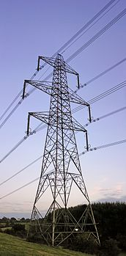
Key Takeaways
Carbon pricing is imperative for least-cost transition and is expanding in PJM
Carbon pricing can co-exist with companion policies
The innovations in RGGI offer an approach that addresses both quantities and prices of reductions and policy interactions.
More robust carbon prices (like NYISO proposal) will provide stronger incentives and do more of the “work”.
Several options exist for dealing with emissions leakage.
Addressing climate change more broadly likely involves a substantial expansion of the electricity sector

Slide 14
Thank you.
Find out more about RFF online: www.rff.org
Follow us on Twitter: @rff
Subscribe to receive updates: rff.org/subscribe

